Slide 1



SQL College of Computing Student Databases Project

Slide 2
Steps:
Identification of students and subject.
Determine the relationships between them.
Connecting tables.
Results review.

Slide 3
database tables:
Std: ID(#std_id),NAME(std_name ),level(std_level).
Course:ID (#course_id )NAME (course_name ),hours(course_hours)
College:ID(#col_id ) NAME(col_name), department (department)
register(std_id number ,foreign key(std_id)references std(std_id),course_id number,foreign key(course_id)references course(course_id) ,year number,sem number)
teach(col_id number, foreign key(col_id)references college(col_id),course_id number,foreign key(course_id )references course(course_id ),teach_number number,teach_name varchar)
Std to register.. one to many
Course to register.. one to many
College to teach.. one to many
Course to teach.. one to many

Slide 4


things used:
create table -- ( )
insert into --- values()
select * from --
01
02
03
04
Create a table
Enter data into a table
View table content
SELECT std.std_id, std.std_name,register.sem ,course.course_nameFROM std, register,coursewHERE std.std_id = register.std_id AND register.course_id = course.course_id;
View related tables

Slide 5
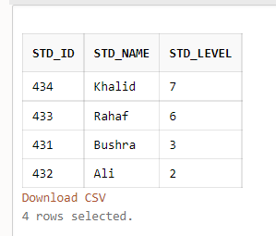
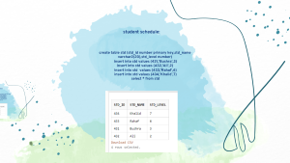
student schedule:
create table std (std_id number primary key,std_name varchar2(20),std_level number) insert into std values (431,'Bushra',3) insert into std values (432,'Ali’,2) insert into std values (433,'Rahaf’,6) insert into std values (434,'Khalid’,7) select * from std

Slide 6
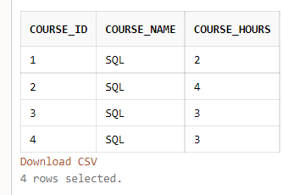
Course schedule:
create table course (course_id number primary key,course_name varchar2(20),course_hours number)
insert into course values (1,'SQL',2)
insert into course values (2,'SQL’,4)
insert into course values (3,'SQL’,3)
insert into course values (4,'SQL’,3)
select * from course

Slide 7
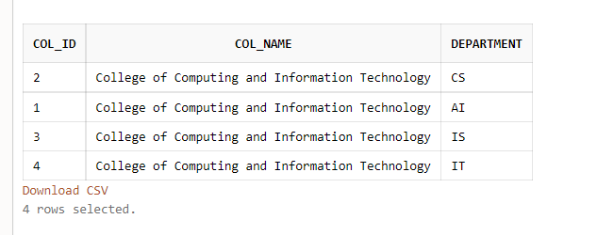
College schedule:
create table college(col_id number primary key,col_name varchar2(100),department varchar2(20)) insert into college values (1,'College of Computing and Information Technology','AI’) insert into college values (2,'College of Computing and Information Technology','CS’) insert into college values (3,'College of Computing and Information Technology','IS’) insert into college values (4,'College of Computing and Information Technology','IT’) select * from college

Slide 8
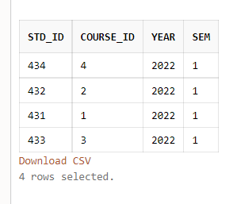
register schedule:
create table register(std_id number ,foreign key(std_id)references std(std_id),course_id number,foreign key(course_id)references course(course_id) ,year number,sem number)
insert into register values (431,1,2022,1)
insert into register values (432,2,2022,1)
insert into register values (433,3,2022,1)
insert into register values (434,4,2022,1)
select * from register

Slide 9
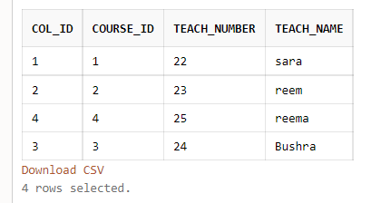
Teach schedule:
create table teach(col_id number, foreign key(col_id)references college(col_id),course_id number,foreign key(course_id )references course(course_id ),teach_number number,teach_name varchar2(20)) insert into teach values (1,1,22,'Sara’) insert into teach values (2,2,23,'Reem’) insert into teach values (3,3,24,'Bushra’) insert into teach values (4,4,25,'Reema’) select * from teach

Slide 10
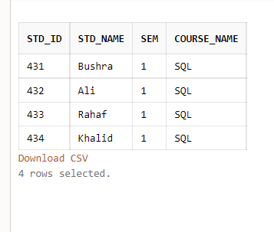
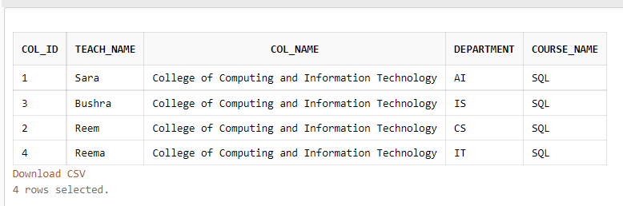
عرض الارتباط بين جدوال :
SELECT std.std_id, std.std_name,register.sem ,course.course_nameFROM std, register,coursewHERE std.std_id = register.std_id AND register.course_id = course.course_id;
SELECT teach.col_id, teach.teach_name,college.col_name,college.department ,course.course_nameFROM teach,college,coursewHERE teach.col_id = college.col_idAND teach.course_id = course.course_id;

